Slide 1
Front-End Development for the MPC in the Cloud Sprint-2
QingXing Li, Yicun Hou, Haoyu Xu
Mentors: Joseph Caiani, Máirín Duffy

Slide 2
Project Overview
The main project is the front end of ChRIS(ChRIS Research Integration System) project
Goal: Design a front-end interface using React & Redux. Receive the input from the user and send the result from MOC to the users.
Sprint1 : Set up the ChRIS Store backend in Docker and rewrited ChRIS Store UI with Redux

Slide 3
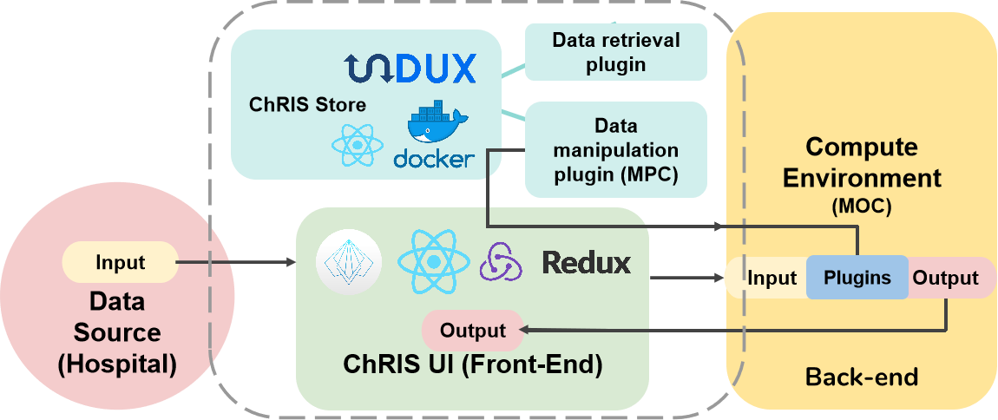
Diagram

Slide 4
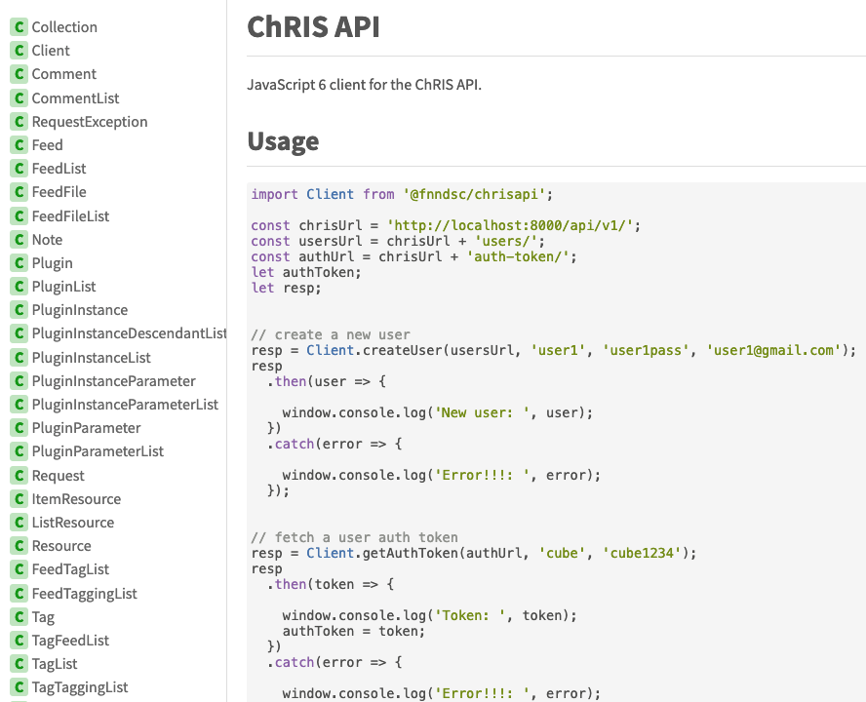
Sprint 2- What we did
Read ChRIS API source files
Wrote TypeScript declaration files for 33 ChRIS APIs and Test it on backend
Temporarily installed the ChRIS UI backend using Docker (The MOC back end will release after March).

Slide 5
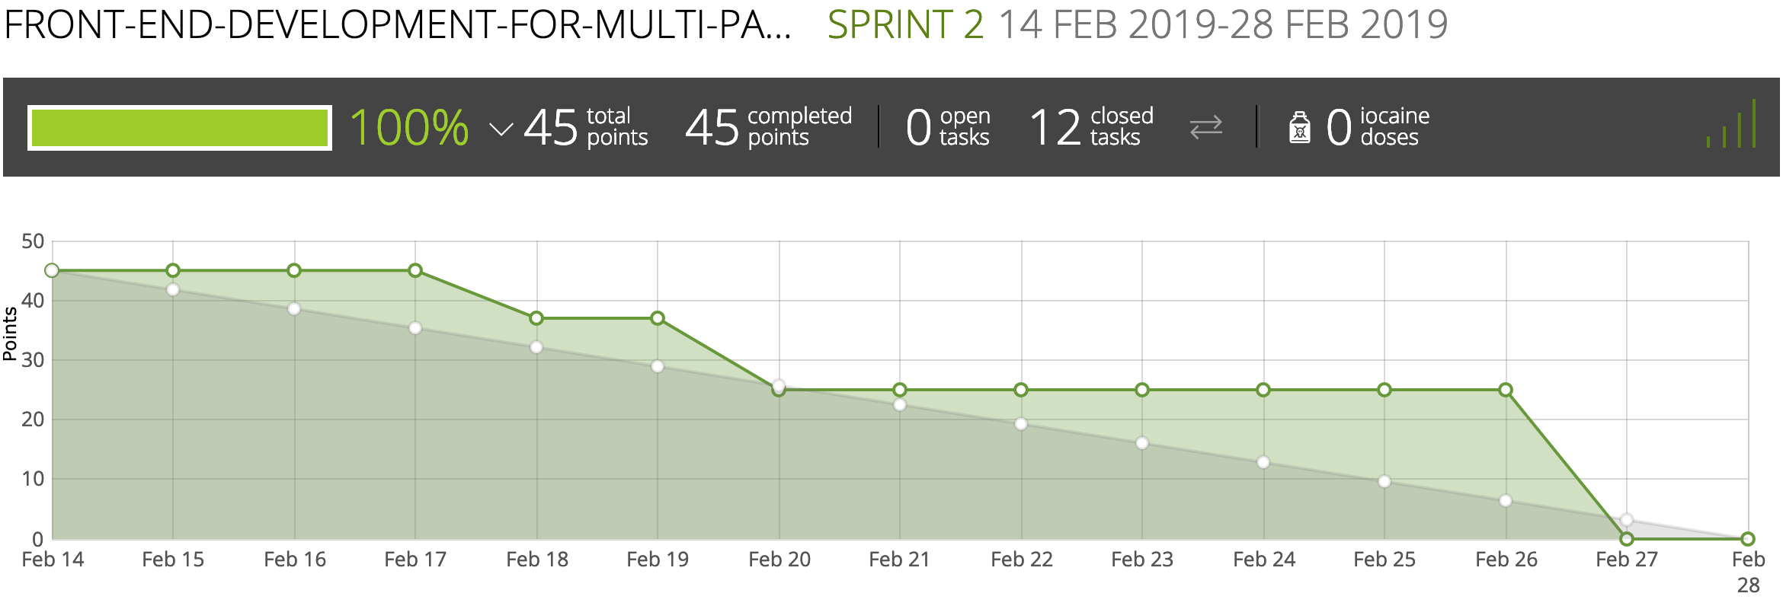
Taiga

Slide 6
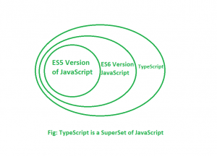
TypeScript
JavaScript is not able to fulfill the requirement of Object-oriented programming.
TypeScript is a strict syntactical superset of JavaScript, and adds optional static typing to the language.
TypeScript is designed for development of large applications and trans-compiles to JavaScript.
Notes:
As Qingxing said before, we used typeScript declared the datatypes of each parameters in the front end. Right now I’m gonna give a brief introduction to the TypeScript.
Since JavaScript is not able to fulfill the requirement of Object-oriented programming. MicroSoft designed the typescript language.
Static typed programming languages are those in which variables need not be defined before they’re used(like Java and C plusplus)
Dynamic typed programming languages are those languages in which variables must necessarily be defined before they are used(like Python)
This means that a program written in a dynamically-typed language (like JavaScript or Python) can compile even if it contains type errors that would otherwise prevent the script from running properly. On the other hand, if a program written in a statically-typed language (like C++) contains type errors, it will fail to compile until the errors have been fixed.

Slide 7
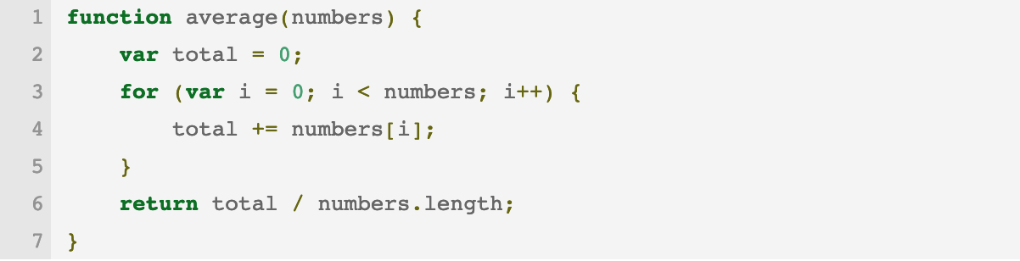
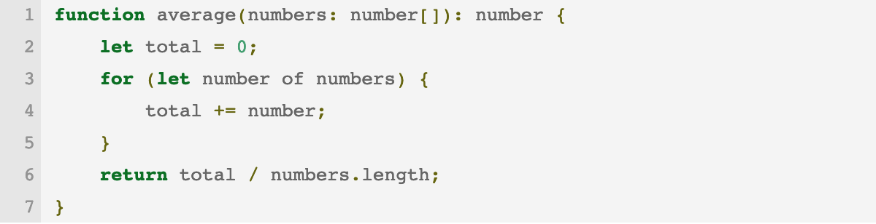
TS vs. JS
JavaScript
TypeScript
Input and output type declarations

Slide 8

Difference between ts and js
TypeScript | JavaScript
OOP | Scripting language
Static Typing | Dynamic Typing
Support modules | Not support modules
Support interface | Not support interface
Notes:
Here are some more details between typescript and javascript.
TypeScript is known as Object oriented programming language whereas JavaScript is a scripting language.
TypeScript has a feature known as Static typing but JavaScript does not have this feature.
TypeScript gives support for modules whereas JavaScript does not support modules.
TypeScript has Interface but JavaScript does not have Interface.
For a large JavaScript project, adopting TypeScript might result in more robust software

Slide 9
Declaration file for API
The "d.ts" declaration file is used to provide typescript type information about an API that's written in JavaScript. The idea is that you're using something like an existing javascript library. You want to consume those from your typescript code.
Rather than rewriting typescript, you can instead write the d.ts file, which contains only the type annotations. Then from your typescript code you get the typescript benefits of static type checking while still using a pure JS library.

Slide 10
Sprint 3- Next to do
Debug the type declaration file
Test the all of the ChRIS API make sure it could work for component and state implement
Create Authentication State and Feed State using Redux for the ChRIS UI(Transfer from javascript to typescript)

Slide 11
Questions?

